Slide 1
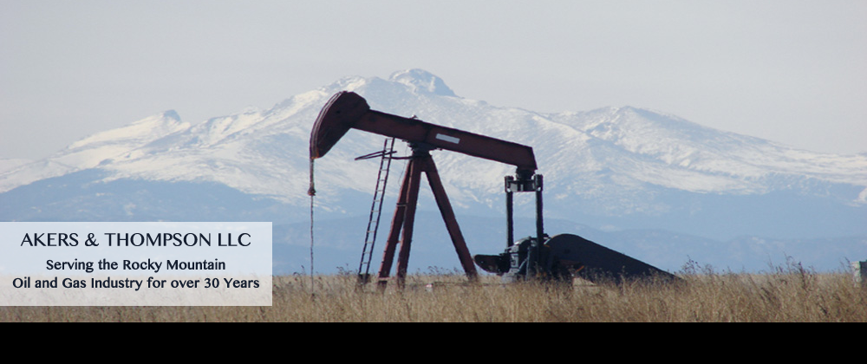

Washouts, Extensions & Renewals of Non-Operating Interests

Slide 2
History of Non-Operating Interests
Interests without the right to operate which were severed from the working interest by grant or reservation.
  Overriding Royalty
  Carried Interest
  Net Profits Interests
  Convertible/Options

Slide 3
DURATION OF Non-Operating Interests
      [T]he life of an overriding royalty is limited by the duration of the lease or other interest from which it was carved or reserved by grant reservation. Termination of the leasehold or other interest out of which the override was carved or reserved will extinguish the override.
      Williams & Meyers, Oil and Gas Law, §418.2

Slide 4
DURATION OF Non-Operating Interests
      Termination of the lease will, by definition, terminate the overriding royalty interest.
      Ogalalla Land, Ltd. v. Wexpro Co., 587 F. Supp. 453 (D. Wyo. 1984).

Slide 5
DURATION OF Non-Operating Interests
      But if the lease itself is extinguished by surrender not amounting to breach of duty … any overriding royalty interest will be extinguished therewith.
      Williams & Meyers, Oil and Gas Law, §418.2

Slide 6
No Unique duty owed to Non-Operating Interests (absent Express Provision)
      No implied duty to drill/explore
      No duty to extend lease beyond primary term

Slide 7
      Some, but not all, duties also owed to Lessor
      Prevent drainage
      Negligent operation
      Duty of good faith and fair dealing
        but no fiduciary duty

Slide 8
History of Washouts
      Another situation in which some courts have protected the holder of the overriding royalty is called a “washout” transaction, generally involving some bad faith on the part of the lessee. In this type of situation, the operator takes a new lease before the expiration of the old lease and then simply permits the old lease to expire.
      Sunac Petroleum Corp. v. Parkes, 416 S.W.2d 798 (Tex. 1967) (citations omitted).

Slide 9
History of Washouts
The intentional termination of a lease to destroy a nonoperating interest is a washout tactic. A washout is conduct by an operator designed to extinguish the overriding royalty interest while at the same time preserving the operator’s interest.
Sawyer v. Guthrie, 215 F. Supp. 2d 1254, 1257 (D. Wyo. 2002).

Slide 10
History of Washouts
“Washout” used to not only describe the bad faith and unfair practice, but also used to describe a potentially good faith situation.

Slide 11
History of Washouts
  Lack of fiduciary duty owed has allowed for the good faith “washout” of non-operating interests.
        Need for Renewal/Extension/Anti-Washout clauses

Slide 12
Anti-Washout/Renewal and Extension Clauses
      Parties can agree to safeguard the owner(s) of non-operating rights by drafting contractual provisions which expressly provide when the owner’s interest will attach and burden subsequent leases.

Slide 13
Anti-Washout/Renewal and Extension Clauses
      The reservation herein shall likewise apply as to all modifications, renewals of such lease or extension that the assignee, his successors or assigns may secure.

Slide 14
Anti-Washout/Renewal and Extension Clauses
      The overriding royalty interest reserved by Assignor in the leases subject to this assignment (the “subject leases”) shall apply to every extension, renewal or modification of any of the subject leases, or any portion thereof, taken by Assignee or its successors, assigns, agents or employees (hereinafter referred to as the “Assignee”), and to any new lease taken by Assignee on the lands, or any portion of the lands, covered by the subject leases within one year of the expiration, termination or surrender of any of the subject leases.

Slide 15
Extension, Renewal, Surrender
      Extension – instrument that stretches the term of an existing oil and gas lease.
      Renewal – continuation of the relationship of the parties with a new lease containing fundamentally the same terms and conditions as the original.
      Surrender – voluntary transfer of all or part of the fee simple estate held by the lessee. Requires some affirmative act by lessee.

Slide 16
Do Clauses change Duty on Lessee/Operator?
    Most jurisdictions, still not a fiduciary relationship
    Depends on the jurisdiction, circumstances and language of the express clause

Slide 17
History of Washouts
    Court held a farmor does not owe a fiduciary duty to the farmee to retain all of the leasehold acreage, even in the case the farmout contained an extension and renewal clause.
    Sawyer v. Guthrie, 215 F. Supp. 2d 1254, 1257 (D. Wyo. 2002)

Slide 18
Override v. Net Profits Interest
An overriding royalty is an interest severed out of the working interest of lessee’s share of the oil, free of the expense of development, operation and production. The duration of the overriding royalty is limited to the life of the lease from which it was created.
Sawyer v. Guthrie, 215 F. Supp. 2d 1254 (D. Wyo. 2002).

Slide 19
Override v. Net Profits Interest
Net profits interests are fractional interests in oil and gas property, usually the working interest, the holders of which have no personal obligation for operating costs, which are are to be paid by the owners of the remaining fractional interests.

Slide 20
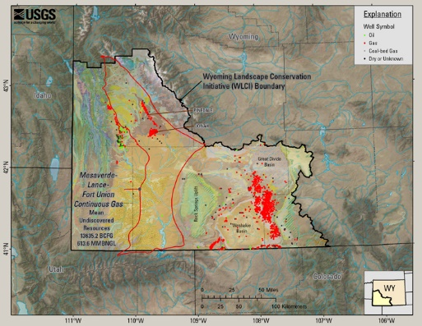
Ultra Resources, Inc. v. Hartman,
2010 WY 26.

Slide 21
Facts of Ultra Resources
1950’s Malco Refineries, Inc., El Paso Natural Gas Company, and Continental Oil Company wanted to develop in Sublette County
Novi Oil Company controlled leases in area
Parties entered into “Agreement for Assignment of Novi Leases and for a Net Profits Interest Pinedale Unit Area Sublette County, Wyoming”
      Novi agreed to commit 3 Federal and 1 Fee lease to proposed Unit in exchange for 5% Net Profits Interest

Slide 22
Facts of Ultra (Cont’D)
Agreement was conditioned on government’s approval of Pinedale Unit
1954, Pinedale Unit was approved, with Unit Agreement being executed by and between Operators, other WI owners and Novi
62 Leases identified on Exhibit A
      Novi’s 4 leases, as well as State of Wyo. Leases 0-11505 and 0-11529

Slide 23
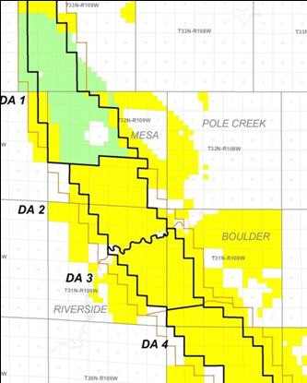
Facts of Ultra (Cont’D)

Slide 24
District COURT Holding (Partial)
NPI survived termination of the Pinedale Unit
Wyo. State Lease 79-0645 is a “replacement lease” under Section 7 of Unit NPI Contract

Slide 25
Ultra District COURT DECISION
Experts testified that over the life of the agreement, leases subject to NPI exceeded $2 billion
Plaintiff’s expert testified over $4 million owed from March 2006 through December 2006
Plaintiffs also awarded $3.9 million for attorney’s fees

Slide 26
Wyoming Supreme Court
NPI survived termination of Pinedale Unit
Wyoming State Lease 79-0645 was a “replacement” of Wyoming State Leases 0-11505 and 0-11529
NOTE: Only two of several holdings in the case

Slide 27
1st Holding of Wyoming Supreme Court
Net Profits Interest created under Unit NPI Contract survived termination of Pinedale Unit

Slide 28
NPI survived termination of Pinedale Unit
Ferguson v. Coronado Oil Co., 884 P.2d 971, 976 (Wyo. 1994) established that the nature of a net profits interest is “determined from the instrument creating the interest.”
No express language in Unit NPI Contract stating NPI terminates upon termination of the Pinedale Unit

Slide 29
      1. NET PROFITS INTEREST
      First Parties agree to pay to Novi a sum or sums representing 5% of the net profits … resulting from operations for oil and gas by First Parties, or any of them, under those certain leases committed to that certain Unit Agreement for the Development and Operation of the Pinedale Unit Area and shown on Exhibit A attached hereto and made a part hereof, such leases being herein referred to as ―said leases.

Slide 30
Wyoming Supreme Court
      Obviously, the parties intended that the leases covered by the Unit NPI Agreement initially be "committed" to the Pinedale Unit under the terms of the Pinedale Unit Agreement ... That does not, however, answer the question of whether the parties intended that the leases be burdened by the NPI only so long as the unit existed.

Slide 31
NPI survived termination of Pinedale Unit
      Court discussed:
      Two of Novi’s assigned leases contained lands both in and out of the Unit
      Unit NPI Contract failed to state NPI terminates upon termination of the Unit
      Only section of Unit NPI Contract that addresses termination of NPI is Surrender Section

Slide 32
7. Surrender
      As to such of said leases as were acquired … from Novi, if First Parties desire at any time to surrender their [leases], … First Parties shall first offer [to] assign the same to Novi . . . . and shall, upon acceptance ... assign such interest to Novi. Upon acceptance of such assignment, First Parties shall be relieved of any and all responsibility or liability hereunder with respect to the interest assigned . . .

Slide 33
7. Surrender (Cont’d)
      Notwithstanding any surrender, release or assignment of interest under the provisions of this section, Novi's net profits interest in operations relating to lands the leasehold interest in which is not so surrendered, released or assigned shall remain a 5% net profits interest.

Slide 34
7. Surrender (Cont’d): Anti-Washout
      In the event any lease is surrendered or released pursuant to the provisions of this section and thereafter First Parties, or any of them, obtain a lease covering lands the leasehold interest in which has been so surrendered, the interest so acquired or obtained by First Parties, or any of them, shall be subject to the provisions hereof, if such new lease is obtained within five (5) years from the date of any such surrender or release....

Slide 35
NPI survived termination of Pinedale Unit
The logical view of the Unit NPI Contract is that Novi permanently gave up its leases in exchange for a permanent 5% NPI, not a temporary one.
Ultra Resources, Inc. v. Hartman, 2010 WY 26.

Slide 36
2nd Holding of Wyoming Supreme Court
    Wyoming State Lease 79-0645 was a “replacement” of Wyoming State Leases 0-11505 and 0-11529

Slide 37
Wyo. State Lease 79-0645 was a “replacement Lease”
    Wyo. State Leases 0-11505 and 0-11529 were listed on Exhibit A of the Unit NPI Contract
    Originally included in Pinedale Unit
    As of contraction of Unit, Mountain Fuel Supply owned 50% of working interest in leases
    Unit contracted in 1977, the State Leases expired in 1979

Slide 38
Wyo. State Lease 79-0645 was a “replacement Lease”
    In 1979 the same lands were leased to Robert E. Ribbe in Wyo. State Lease 79-0645
    In 1980, Mountain Fuel Resources, a subsidiary of Mountain Fuel Supply, acquired leasehold of Wyo. State Lease 79-0645
    Leasehold then assigned to Questar, who assigned the same to Ultra, et al. (Defendants)

Slide 39
7. Surrender (Cont’d): Anti-Washout
      In the event any lease is surrendered or released pursuant to the provisions of this section and thereafter First Parties, or any of them, obtain a lease covering lands the leasehold interest in which has been so surrendered, the interest so acquired or obtained by First Parties, or any of them, shall be subject to the provisions hereof, if such new lease is obtained within five (5) years from the date of any such surrender or release....

Slide 40
“Termination” of Prior State Leases
    Defendants argued Wyo. State Leases 0-11505 and 0-11529 “terminated”
    Termination – expiration of a lease by its own terms for the failure of operator/lessee to sustain operations on the leased premises, or lands pooled therewith

Slide 41
Wyoming State Leases 0-11505 and 0-11529
    Court disagreed
      August 11, 1977, Operator of Pinedale Unit notified other owners that in planned to activate the automatic elimination provision under the Unit Agreement
      October 12, 1977, Operator informed the USGS of the same

Slide 42
Wyoming Supreme Court
    Correspondence from operator stated it:
      Planned no activity
      Inaction will activate automatic elimination
      “Acceded” to automatic elimination
      Affirmative action = Surrender

Slide 43
Wyoming Supreme Court
    There is simply no question that El Paso affirmatively yielded possession of the leases to the lessor (State of Wyoming). Until El Paso filed its development plan of "no activity," the original state leases remained in effect as part of the Pinedale Unit. The letters make it very clear that El Paso (as operator) had the power to determine how to proceed with the unit and leases included within the unit.

Slide 44
Wyoming Supreme Court
    By filing a plan of no activity, the operator acceded to the contraction of the unit. This action was a surrender that triggered the anti-washout provision. When a successor of the First Parties re-acquired the same lands in State Lease No. 79-0645 within the five year period set out in Section 7, the NPI attached to the new lease.

Slide 45
Wyoming Supreme Court
    The anti-wash provision was designed to protect the plaintiffs (as successors to Novi) from the exact situation that happened here - surrender of the lease followed by a subsequent reacquisition of the same property by the same lessee.

Slide 46
Take away from Ultra v. Hartman
  Remember abbreviated discussion of case
  Must review clause/contract between the parties
  Apply facts of the case to the clause/contract

Slide 47
QUESTAR Exploration and Production Company v. ROCKY MOUNTAIN RESOURCES, LLC, 2017 WY 10.
      It’s like déjà vu all over again –
      Yogi Berra

Slide 48
QUESTAR v. ROCKY MOUNTAIN
ISSUE: Whether or not Wyoming State Lease 79-0645 was a “renewal, substitute or new lease” of Wyoming State Leases 0-11505 and 0-11529
Rocky Mountain argued its predecessor’s 4.0% ORI in two 1951 leases should extend to the 1979 lease because of the “anti-washout clause” contained in the assignments creating the overrides.

Slide 49
FACTS OF QUESTAR
  In 1951, State of Wyoming issued Wyo. State Leases 0-11505 and 0-11529 (“1951 Leases”)
  Lease 0-11505 covered 160 acres in Section 16, T32N, R109W
    Issued to Gwen Keif as Lessee
  Lease 0-11529 covered remaining 480 acres in Section 16
    Issued to Walter Davis as Lessee
  In 1952, Lease 0-11505 was assigned to Davis

Slide 50
Davis Anti-Washout Clause
  In 1953, Davis conveyed leases to Continental Oil Company, while reserving a 4.0% ORI with the following clause:
  TO HAVE AND TO HOLD unto the said Continental Oil Company, its successors and assigns, subject to the terms and conditions of said lease; the grants and reservations herein contained extending to any renewal lease, substitute lease or new lease issued in lieu thereof with full effect.

Slide 51
FACTS OF QUESTAR (Cont’d)
  In 1954, Continental, et al. acquired approval from WSLB to commit 1951 Leases into Pinedale Unit
  Through various farmouts and assignments, Mountain Fuel Supply earned 50% of the working interest in the 1951 Leases
  Pinedale Unit contracted 1977, resulting in the 1951 Leases expiring under their own terms in 1979

Slide 52
FACTS OF QUESTAR (Cont’d)
WSLB required to re-lease the lands through a public drawing and decided to combine the acreage formerly covered by the 1951 Leases into one parcel (i.e., all of Section 16).
In November 1979, Dr. Robert Ribbe prevailed over the other 1,146 applicants and was issued Wyo. State Lease 79-0645 covering all of Section 16

Slide 53
FACTS OF QUESTAR (Cont’d)
In December 1980, Mountain Fuel Resources, a subsidiary of Mountain Fuel Supply, acquired Wyo. State Lease 79-0645
That same year, Wyo. State Lease 79-0645 was included in, and committed to the Mesa Unit

Slide 54
LEADING UP TO LITIGATION in QUESTAR
  Questar Energy Company (QEP) and Wexpro Corporation (Wexpro) acquired the working interest of Wyo. State Lease 79-0645, while Rocky Mountain Resources succeed to the 4.0% Davis ORI in the 1951 Leases.
  It should be noted that as of February 2015, there were 119 producing wells on Wyo. State Lease 79-0645.

Slide 55
District Court
Relied on Ultra Resources v. Hartman, and held Wyo. State Lease 79-0645 was a renewal, substitute or new lease of the 1951 Leases, which resulted in the 4.0% ORI extending to the 1979 Lease.

Slide 56
QUESTAR - District Court
The jury ruled in favor of Rocky Mountain, and found QEP liable for $16,734,040 and Wexpro liable for $14,146,441, along with the liability of paying future royalties.

Slide 57
Wyoming Supreme Court
Reversed District Court’s holding, and determined Wyo. State Lease 79-0645 WAS NOT a renewal, substitute or new lease of the 1951 Leases.
Compared language of Unit NPI Contract with Davis’ Anti-Washout Clause

Slide 58
Unit NPI Contract from Ultra
      Section 7. Surrender
      In the event any lease is surrendered or released pursuant to the provisions of this section and thereafter First Parties, or any of them, obtain a lease covering lands the leasehold interest in which has been so surrendered, the interest so acquired or obtained by First Parties, or any of them, shall be subject to the provisions hereof, if such new lease is obtained within five (5) years from the date of any such surrender or release....

Slide 59
Anti-Washout Clause
  TO HAVE AND TO HOLD unto the said Continental Oil Company, its successors and assigns, subject to the terms and conditions of said lease; the grants and reservations herein contained extending to any renewal lease, substitute lease or new lease issued in lieu thereof with full effect.

Slide 60
Wyoming Supreme Court
  Not a renewal, substitute or new lease:
  (1) Wyo. State Lease 79-0645 covered all of Sec. 16, prior leases covered two distinct parcels;
  (2) Wyo. State Lease 79-0645 contained “substantially different terms” from the 1951 Leases;
  (3) Wyo. State Lease 79-0645 leased by a stranger-to-title lessee; and
  (4) Dr. Ribbe was not a straw-man for Mountain Fuel Supply

Slide 61
CONTRASTING two cases
  Every situation is different, must read the Agreement, Contract, Assignment
  Same/Similar facts applied to two different clauses resulted in different outcomes

Slide 62
Take Caution regarding Questar case
  It remains to be seen, however, whether substituting a lease requiring delay-rentals with a paid-up lease, decreasing/increasing the primary term, or decreasing/increasing the landowner royalty due rise to the level of “substantially different terms.”
  Probably requires something more substantial.

Slide 63
Thanks and Questions
Contact Info:
Eric Thompson
ethompson@akersthompsonlaw.com
akersthompsonlaw.com
(720) 488-0835

